Slide 1
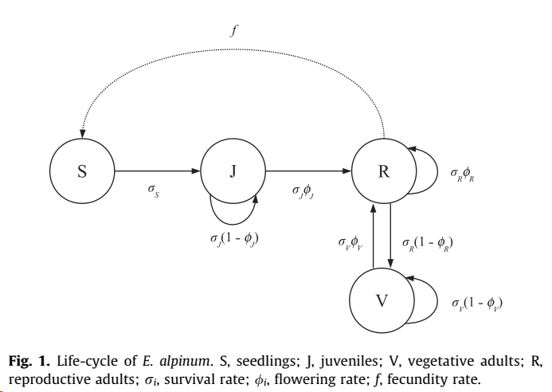
Analysis of vital rates
Survival probability, σ, J, V, R
Flowering probability, φ, J, V, R
Fecundity, f

Slide 2
Environmental predictors Years 2014-2021, iButton data
Calculation on interval between snowmelt day up to 120 days later
snowmelt: first two days with T > 0 after March 15th
Two variables:
ddays: Degree days: should be correlated positively to vital rates
num_s_Tmin_15: Number of stressful hot periods: number of periods with at least 3 consecutive days with Tmin > 15 °C should be correlated negatively to vital rates

Slide 3
Analysis of survival probability
GLMM – Bernoulli
surv(0,1) ~ State[J,V,F] * Site * (ddays + num_s_Tmin_15) + (1| ID)
Model selection (AIC):
surv(0,1) ~ State[J,V,F] * Site + (ddays + num_s_Tmin_15)
Individual as random term (repeated measures)

Slide 4
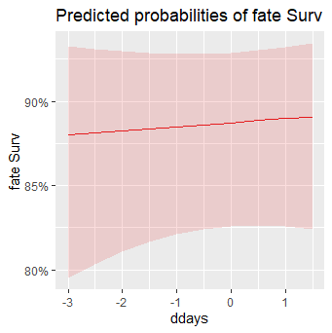
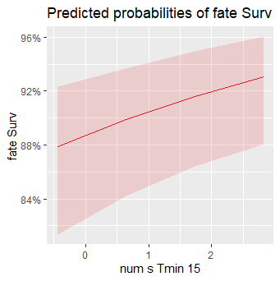
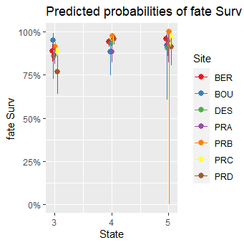

Slide 5
Boosted Regression Trees
Francon et al 2020:
bootstrapped correlation functions (implemented in the R package treeclim as an ad-hoc method for ring tree analysis) → not directly applicable to our dataset
structural equation modelling (R package lavaan)
Boosted Regression Trees (eXtreme Gradient Boosting, R package XGBoost)
variable importance
prediction

Slide 6
Predictors
Degree-days: between snowmelt day up to 150 days later
num_sp_Tmin_10 num_sp_Tmin_15 num_sp_Tmax_25 num_sp_Tmax_30
num_sd_Tmin_10 num_sd_Tmin_15 num_sd_Tmax_25 num_sd_Tmax_30
Site
State (J, V, F)
Number of stressful hot periods: number of periods with at least 3 consecutive days with Tmin or Tmax above a threshold
Number of stressful hot days: number of days in periods with at least 3 consecutive days with Tmin or Tmax above a threshold

Slide 7
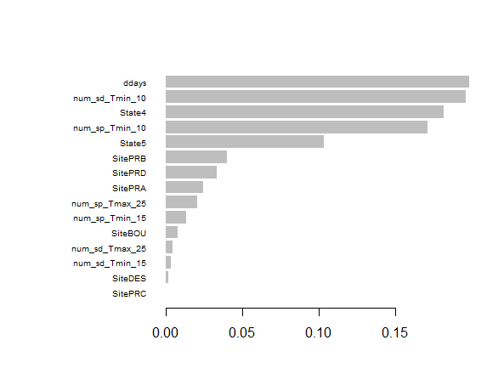
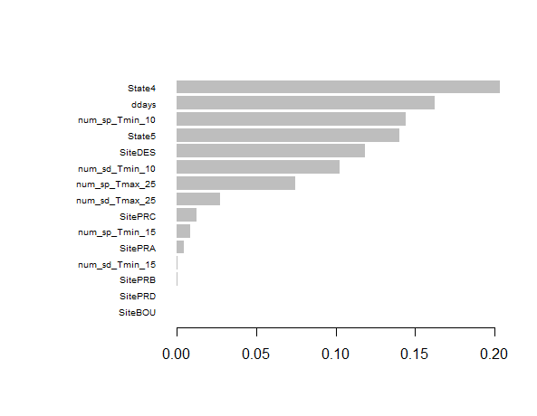
Survival probability Flowering probability

Slide 8
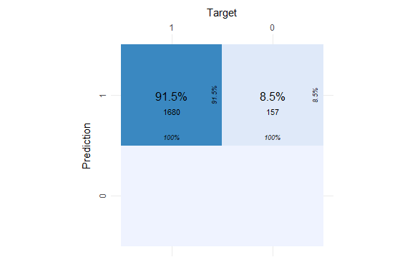
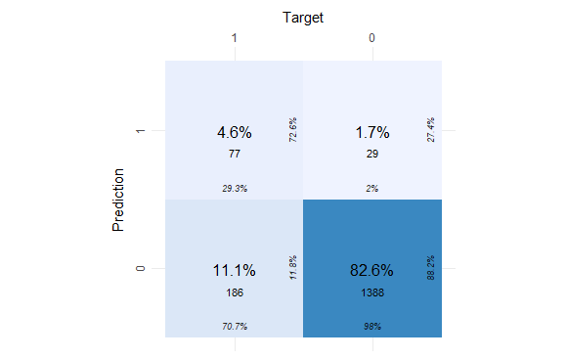
Survival probability Flowering probability

